Slide 1
HIDDEN GEMS: DISCOVERING FINANCIAL BRILLIANCE
Session 31
Presented by Bernard Mostert

Slide 2
https://www.linkedin.com/pulse/innovating-finance-role-custom-fintech-software-development-isla/?trk=public_post
Notes:
I talk about gems and financial brilliance – but what does it mean?
With financial brilliance, it simply means I want to ensure that you have a better understanding of some functionality that exists in the system, that would allow you to effectively handle tasks.
Let’s discuss the functionality in the different areas and if there are questions, please let me know.

Slide 3
Procurement Management
General Ledger
Student Debtors
Accounts Receivable
Bursaries and Loans
Cash Book
TABLE OF
CONTENTS

Slide 4
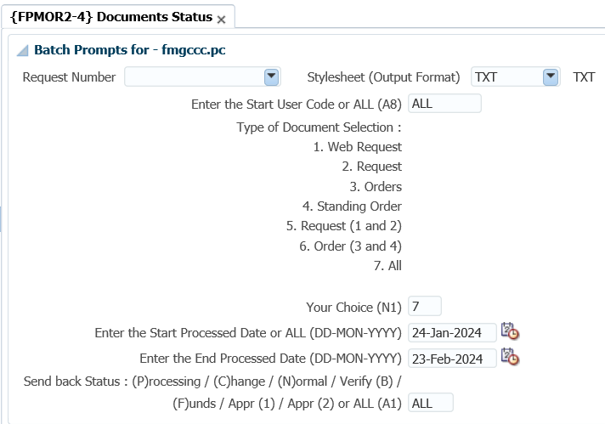
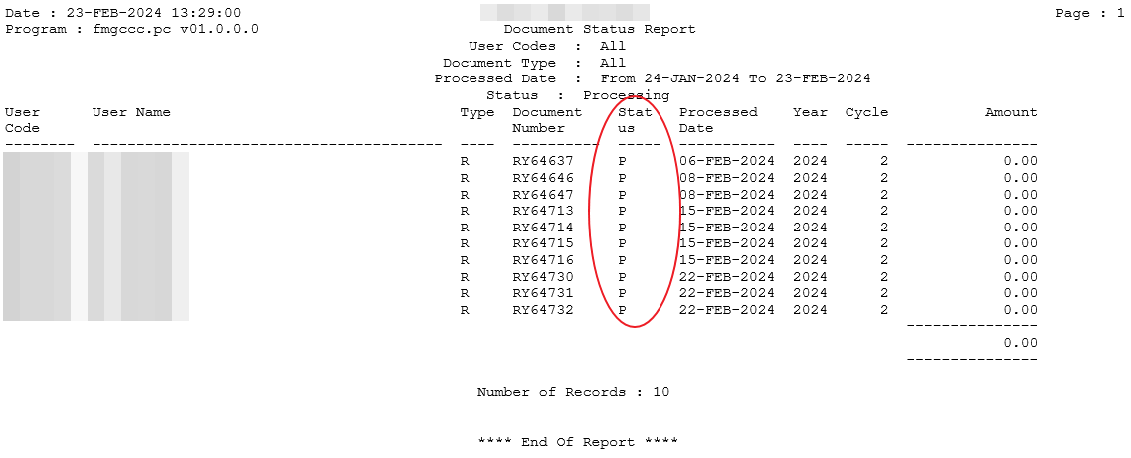
PROCUREMENT MANAGEMENT SYSTEM
What status are the documents? {Fpmor2-4}
Notes:
FPMOR2-4 status report of the documents

Slide 5
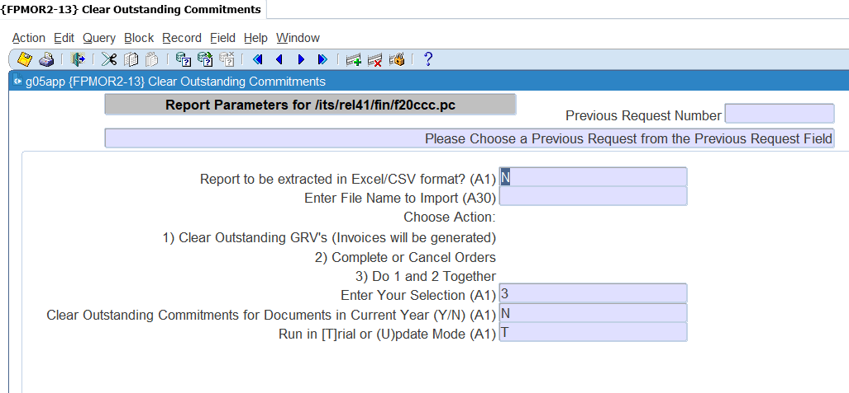
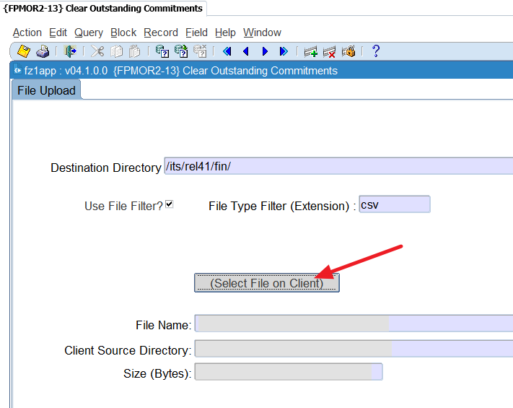
PROCUREMENT MANAGEMENT SYSTEM – CONT.
How do i get rid of outstanding commitments? {Fpmor2-13}
You will have three options BUT execute in trial first.
1. Clear outstanding GRVs (invoices will be generated) – Commitments are cleared by generating the invoices and cancelling them.
2. Complete or cancel orders – Commitments are cleared by completing or cancelling the orders.
3. Do 1 and 2 Together: this option will apply both option 1 and 2
Notes:
FPMOR2-13 removing commitments
First run the outstanding commitments report in {FPMOR2-6. Please the input parameters are critical as these are the commitments you want to delete.
You will use that report to compile a report that will be used in the report {FPMOR2-13} to remove the commitments.
Make sure the file path is completed in {BATCH-7} against the function ‘OUTCOM’
When you access the option it will first allow you to upload the file you compiled…
Then after you upload the file and click exit it will look like a report. Click enter and it will display the parameters.

Slide 6
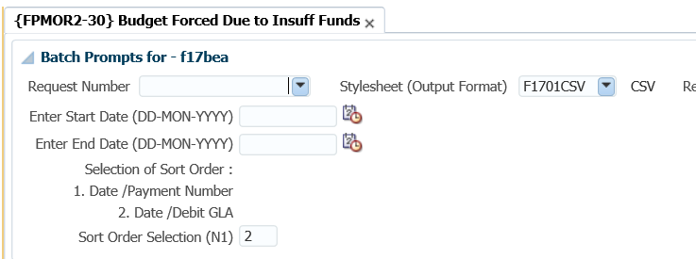
PROCUREMENT MANAGEMENT SYSTEM – CONT.
Who forced the transaction when there were insufficient funds? {Fpmor2-30}
Notes:
FPMOR2-30 who forced a transaction because of insufficient funds?
Unfortunately, this will only work if you load a budget on the system. I know not everybody loads their budgets, but remember the functionality of checking for funds is very powerful in the Integrator system.
You can look at the user code and quickly determine who may override and who shouldn’t – that means the restrictions could be an issue if that is not correct

Slide 7
PROCUREMENT MANAGEMENT SYSTEM – CONT.
Contract functionality
Document storage – linking the contract to the contract
Code structure – contract type and contract classification
Length of the contract
Works with item codes
Linking the item to the creditor
Define the contract and link to the creditor
Values and items on the contract
Notes:
Do you record contracts on the system?
This is just very high-level info on the contract functionality in PM system.

Slide 8
GENERAL LEDGER SYSTEM
Batch journal functionality – {FGLO-12}
Please note – the option does the usual validations as if you are processing a journal in {FGLO-1 or 2}.
https://www.connectioncafe.com/how-quick-financial-transactions-can-benefit-your-business/
Notes:
Batch journals
Here you can prepare the GL journal in Excel.
After you uploaded the file in BATCH-26 you can load the journal in {FGLO-12} – similar to {MEBO-9} where you load budget entries.

Slide 9
GENERAL LEDGER SYSTEM – CONT.
Did you know that if you use GL journal approvals, you can have them as commitments if they are not approved yet?
Notes:
Commitment Journals
You will define a commitment GL journal TT and link a “normal” journal TT to it.
What happens when you process the journal the system records this as a commitment, once it is approved it makes it an actual, or when rejected it removes the commitment.
There is the SOD you need to set, before you can use it.

Slide 10
GENERAL LEDGER SYSTEM – CONT.
What do all the columns mean when looking at some reports?
Notes:
When you are executing TT reports, account summary reports or CC reports, there may be differences – although there should NOT be…
Do you know what these columns mean?
The green one is the originating sub system – where was this processed?
The green one shows where is it now – pay attention to the last record. It says PM – so means that transaction is not posted yet.
What does it mean? Some GL reports may not include that transaction. Be careful.
Validation of CC structure

Slide 11
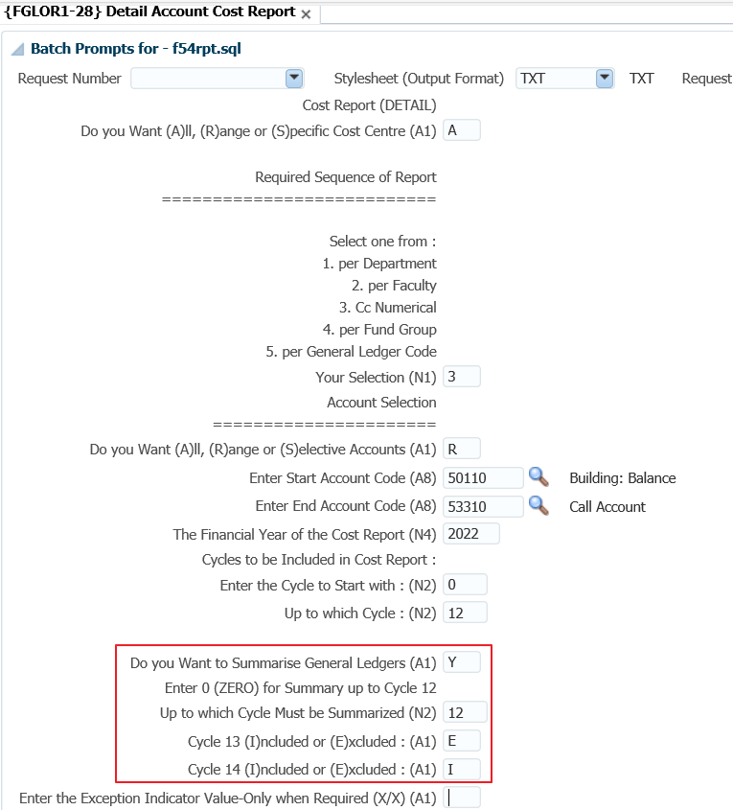
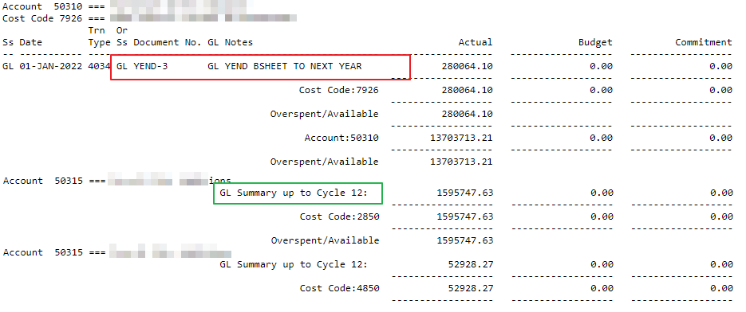
GENERAL LEDGER SYSTEM – CONT.
How do you get only the opening balance of a specific account?
Notes:
When you look at the detail report CC or account – {FGLOR1-8/28} you need to pay attention to the parameters:
The section I have blocked…
Those parameters can be explained as follow – summary the important one, while you also need to pay attention to cycle 13 and 14.
The output will have the opening balance and the summary – if there were entries in that financial year will shows summary up to the selected cycle.
Validation of CC structure

Slide 12
GENERAL LEDGER SYSTEM – CONT.
Imbalance on your TB?
Notes:
You execute the TB and have an imbalance, yes it sounds like an easy problem, but I want to recap how you should use the reports that are available.
You all start with the transactions on invalid GLA’s report – {FGLPR1-3}.
Then you run the account structure validation – {FCSO-3} and then the
Validation on the CC structure – in {FCSO-2}. This is where you could miss some valuable information.
You will probably complete the following values – all financial years and complete validation.
Rather insert the financial year where you have the imbalance AND the consolidation CC code that you used for the TB.
Just a last reminder – what you can also look at before doing the validations, is to run the account summary report in {FGLOR1-26}. If that report is in balance, you know it is a consolidation structure that is wrong. If this report has an imbalance, then run the TT report in {FGLOR1-21} for the specific year, BUT in summary, for all cycles – 0 to 14 and all TT’s.

Slide 13
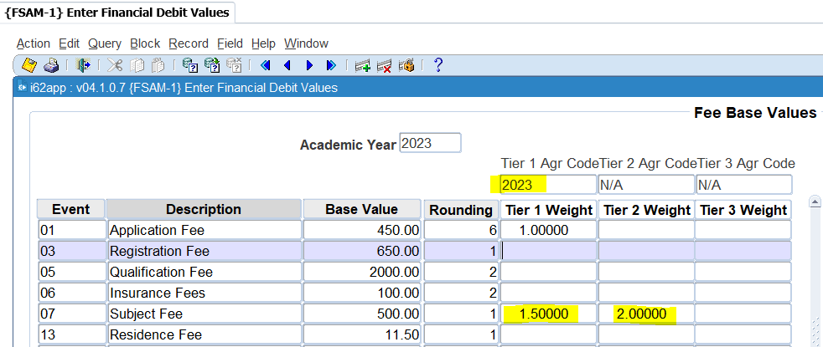
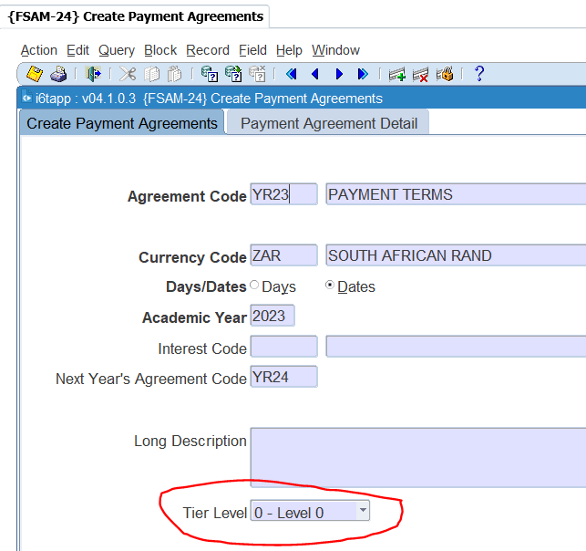
STUDENT DEBTOR SYSTEM
Do you have different fees because of a payment agreement – no interest?
Notes:
What do you do, where you want different pricing models because of the installment plans?
First you will have to indicate on the SOD that you want to use tier pricing.
Then you will define the payment agreements and LINK that to a tier. There can only be one payment agreement, per currency and tier combination.
The on your fee structure, you will see additional fields where you will indicate the weight.
Remember the weight is a factor you will use to multiply the standard fee to get the higher price.
On the second block, you can see the price for the immediate payment, and then higher prices as you take longer to make a payment.

Slide 14
STUDENT DEBTOR SYSTEM – CONT.
Contracts in the student debtor system.
Allows you to define a contract with ‘rules’ on who and what will be paid:
Premium or discount on fees
Only tuition or residence fees
Only first-time subject registration
Charges the student. Will allow you to invoice a debtor.
Notes:
Have you heard of the functionality of the contracts in the SD system?
The functionality has SOD’s that you start with, in addition to some account types.

Slide 15
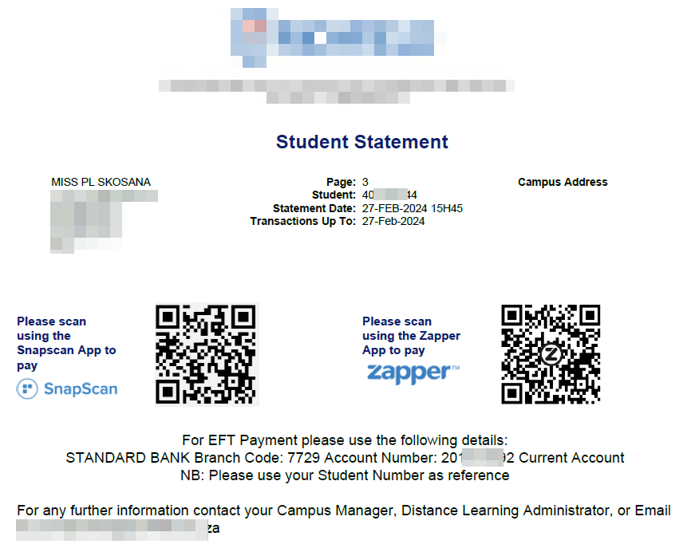
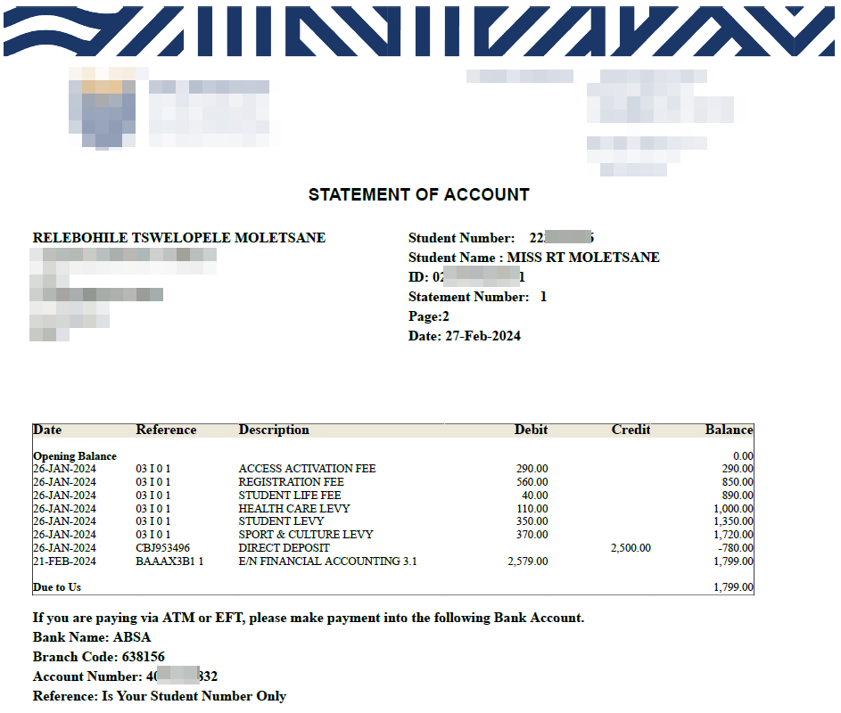
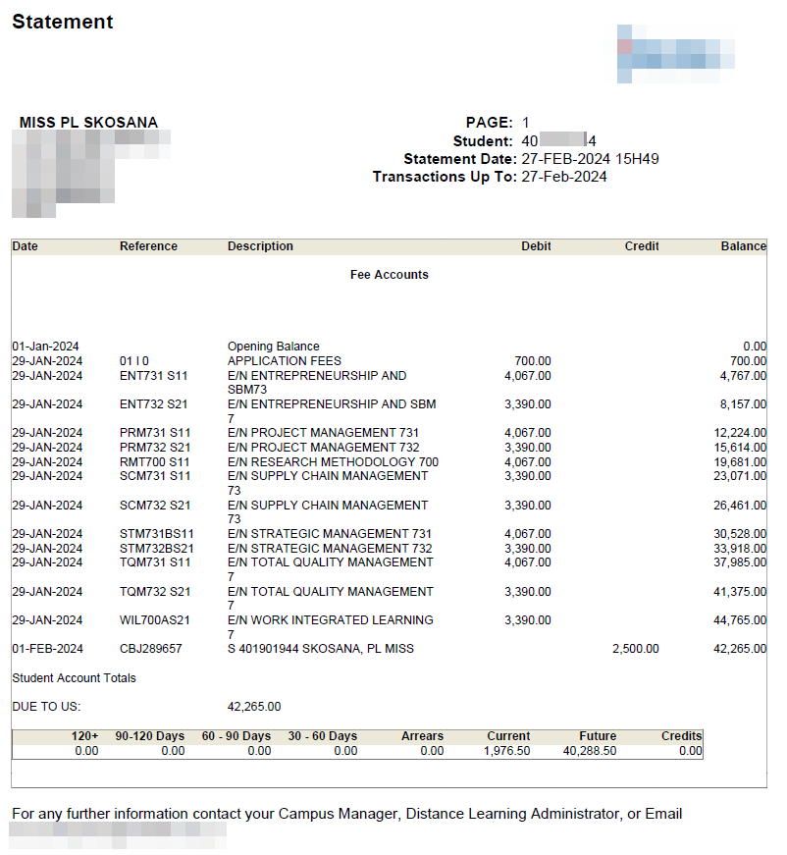
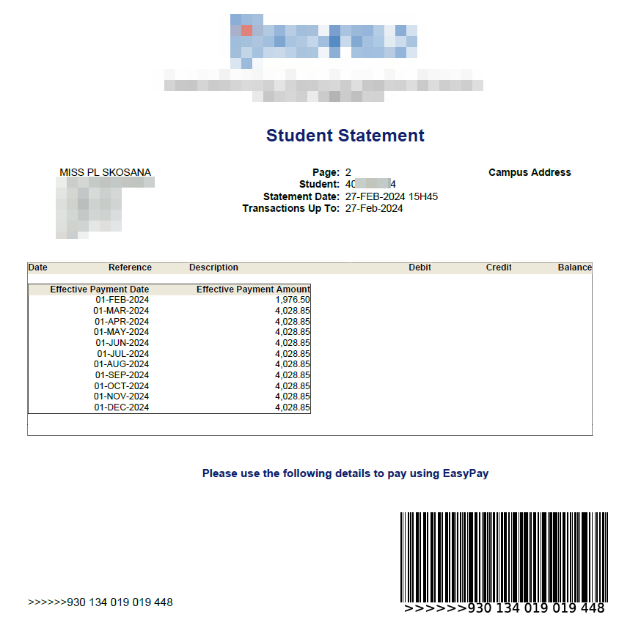
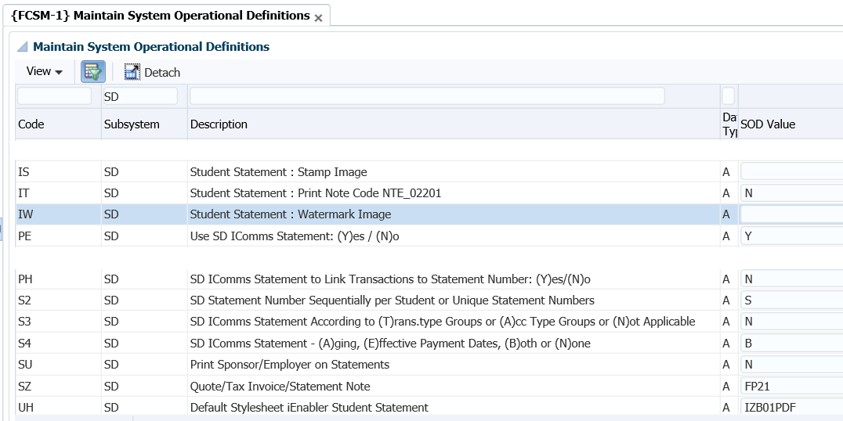
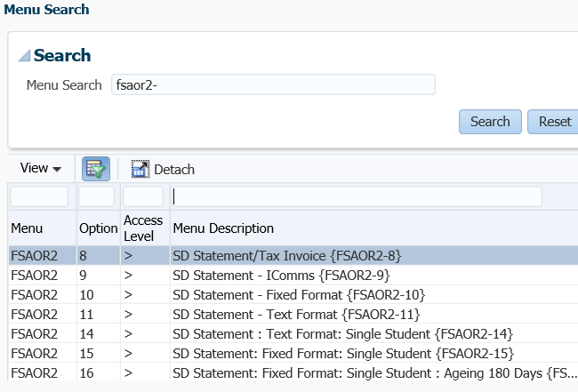
STUDENT DEBTOR SYSTEM – CONT.
Student statements
FSAOR2-9
FSAOR2-10
FSAOR2-16
Notes:
How do the students view/receive their statements?
There are a number of SOD’s that manages the use of the statements, as well as a number of statement options.
I have included a few examples what the statements look like – just to remind you of the functionality that is available…

Slide 16
ACCOUNTS RECEIVABLE SYSTEM
Do you have sundry debtors? Do you administer them on the Integrator system?
Does your statements to them ONLY display their outstanding invoices?
Do you age ONLY the outstanding invoices?
https://www.gvinc.law.za/hows-that-debtors-book-reading/
Notes:
If you didn’t answer yes to all three questions, please listen to this…
We have functionality available, that allows you to link payments that you receive from debtors to the specific invoice that they are paying. If you didn’t know, by NOT using this functionality, you simply show the debtor a list of his invoices and payments received – with the outstanding balance at the bottom.
With the open item, we allow you to flag WHICH invoice the debtor has paid.

Slide 17
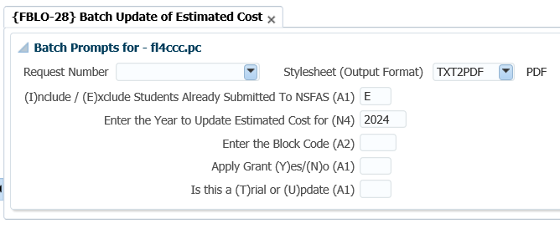
BURSARIES AND LOANS SYSTEM
Challenges with the students’ estimated cost?
Notes:
{FBLO-4}, estimated costs were loaded but that was done before residence registration took place. You can update the estimated costs in batch.
Look at FBLO-28. Remember that we allow you to update the estimated costs with the real costs of tuition and residence fees. You will get a report that shows the differences, but look at the TRIAL and update options.
Loading data in batch

Slide 18
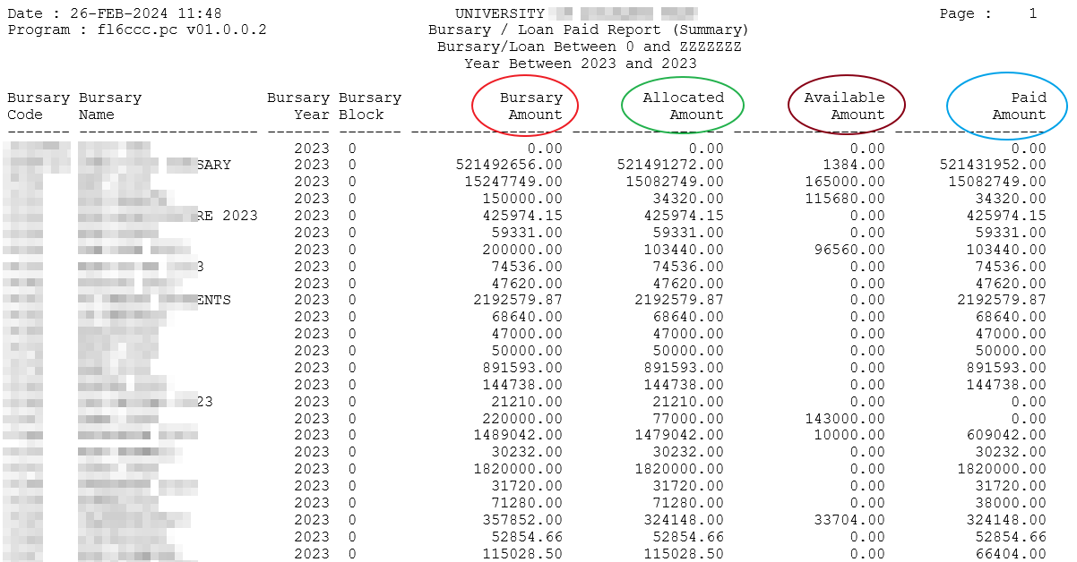
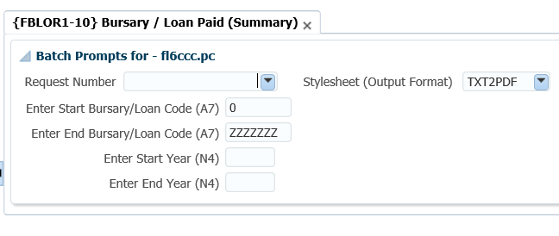
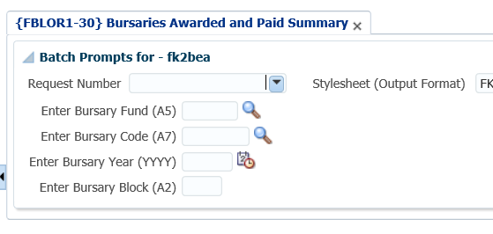
BURSARIES AND LOANS SYSTEM – CONT.
Do you know which bursaries have amounts available?
Notes:
{FBLOR1-10}, will give you a summary of what you have available on your bursary. Here with some more details.
Remember to update the values in {FBLO-1} – that is the bursary amount in the first column.
Allocated – what you allocated in {FBLO-4/6}
Available – here you have the bursary amount minus what you allocated
Paid – is what you copied to SD
Some may comment, but this is the same as {FBLOR1-6} – that is correct, but this is a summary.
Loading data in batch

Slide 19
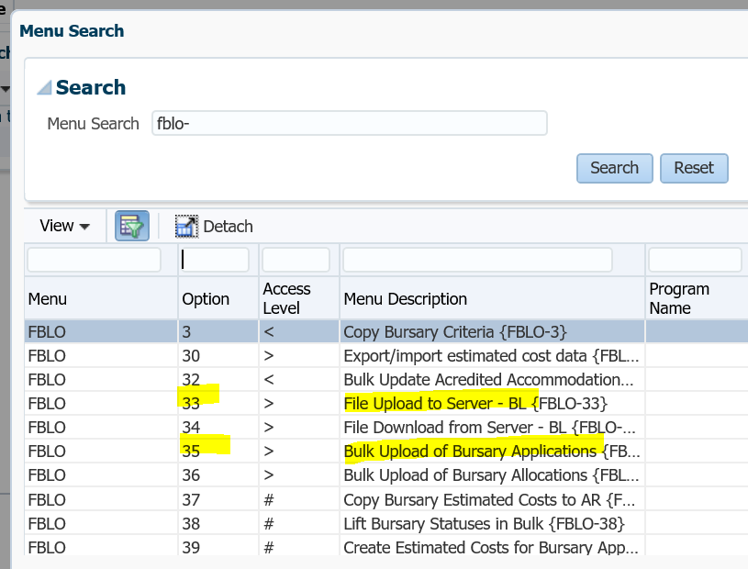
BURSARIES AND LOANS SYSTEM – CONT.
How do you record bursary applications?
Notes:
Bulk upload of bursary applicants – this can be done with the option {FBLO-35}. You will first load the file to the server, using the option {FBLO-33}.
Yes, you guessed it, you can also do the allocations {FBLO-36}, but the file is uploaded via the menu option {BATCH-26}.

Slide 20
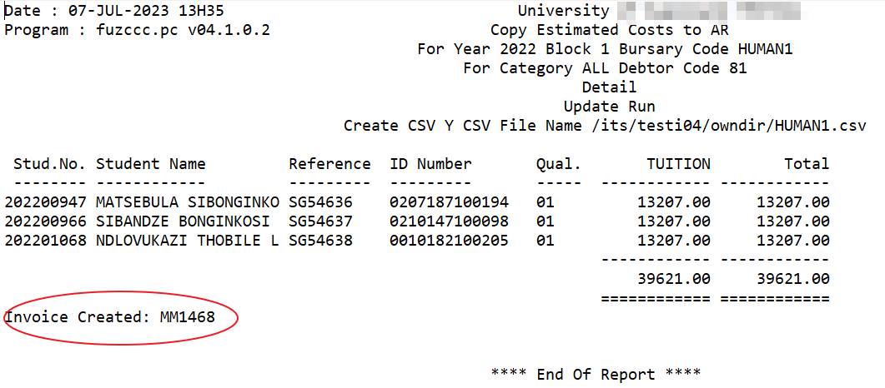
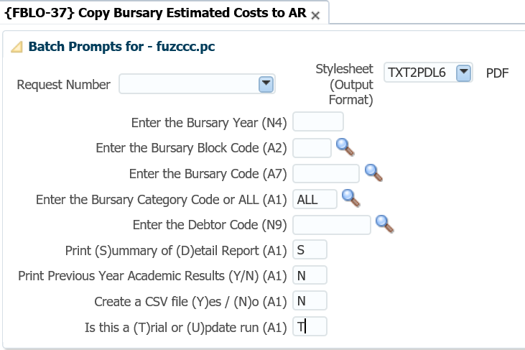
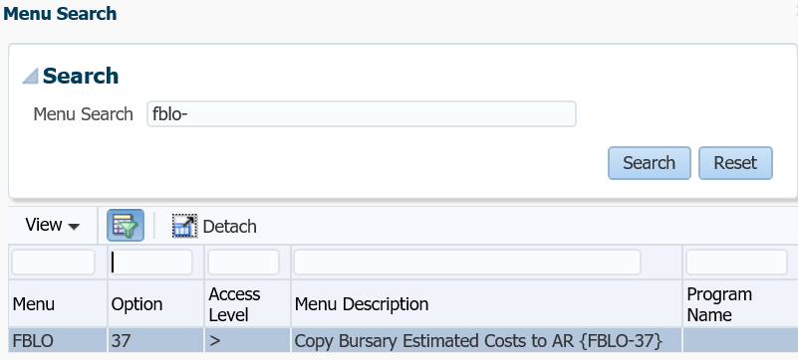
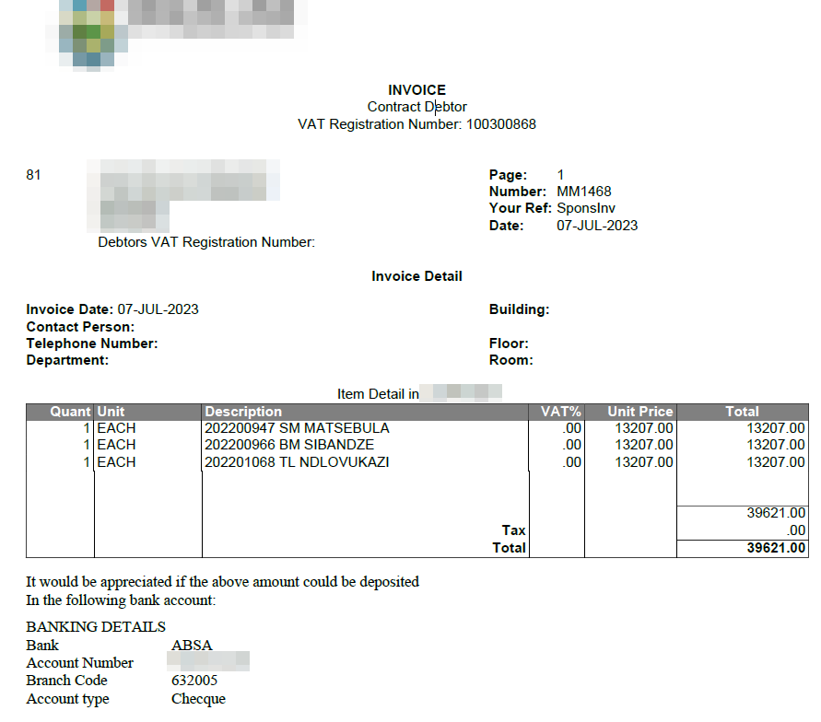
BURSARIES AND LOANS SYSTEM – CONT.
Other monies – not NSFAS?
Notes:
Do you have bursaries that are administered, but where the sponsor is expecting an invoice? NOT NSFAS money.
We have the functionality for the contracts, but do you know about the bursaries and the AR system? Have a look at this option.
Just note that it is looking at THE ESTIMATED costs.
What the option does it will create the invoice for the specific debtor.

Slide 21
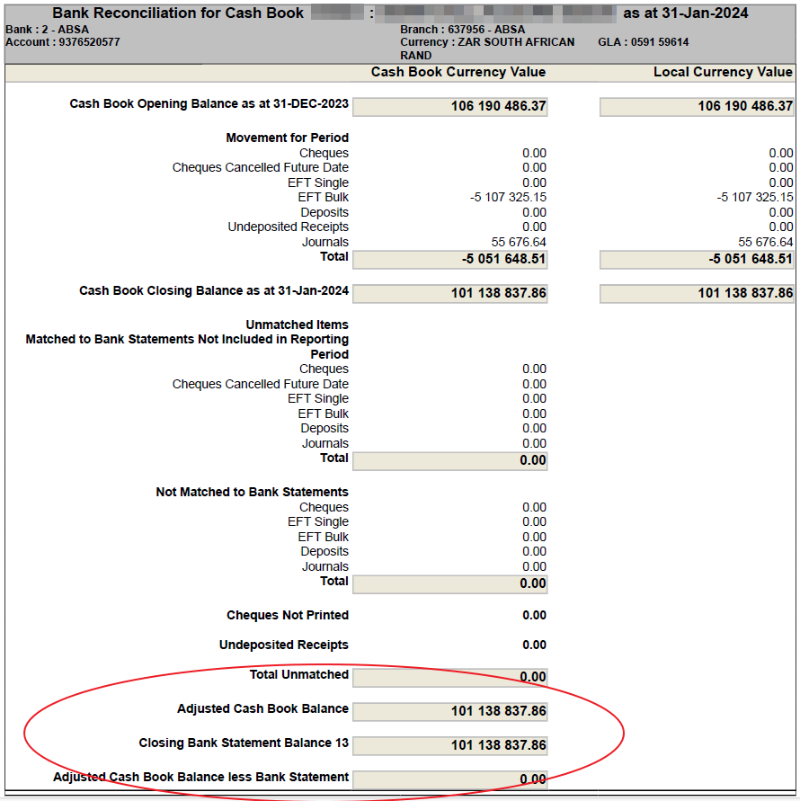
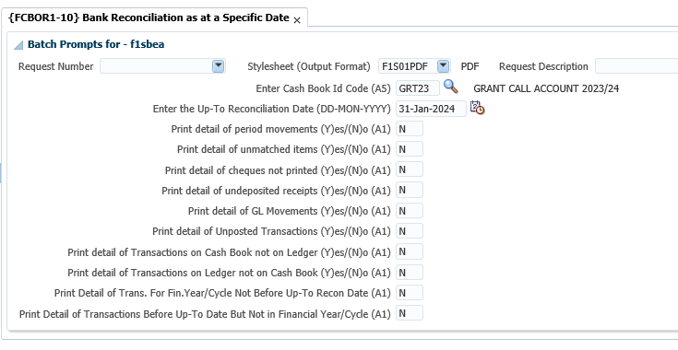
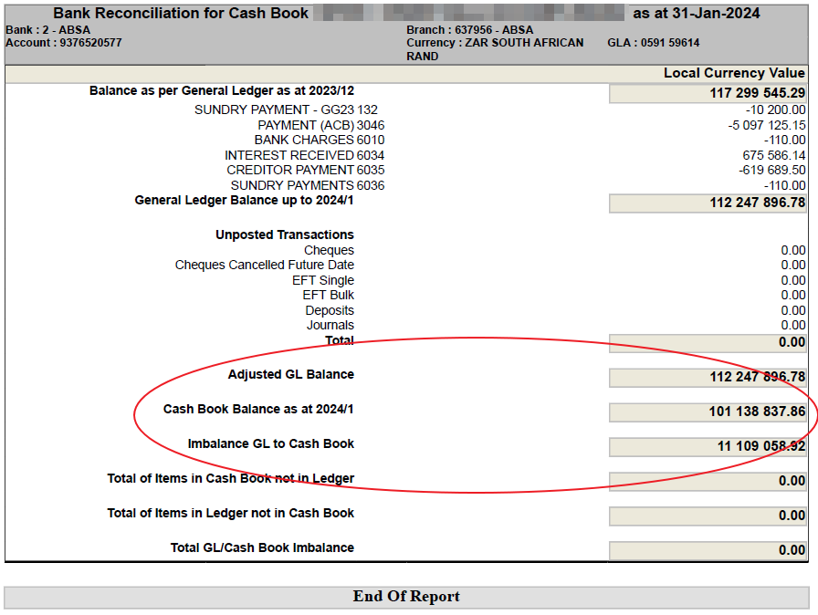
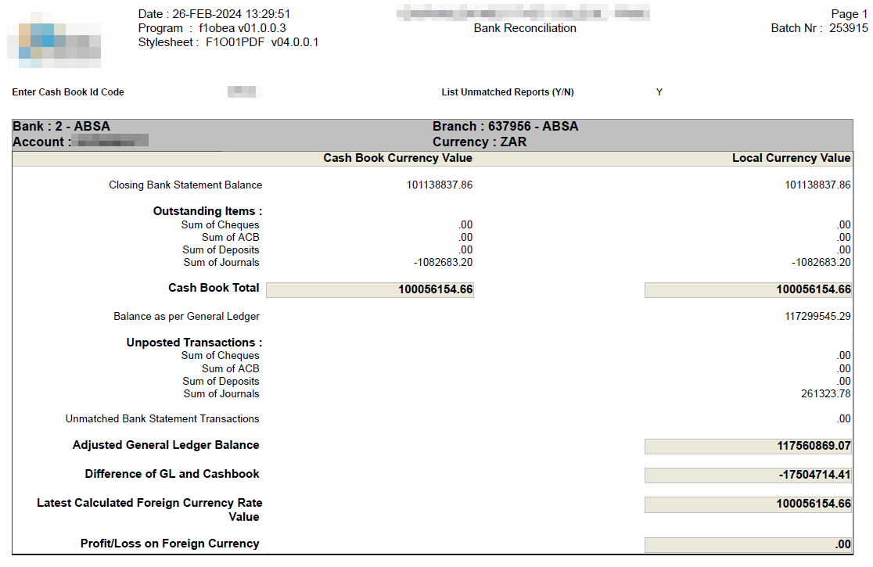
CASH BOOK SYSTEM
Bank reconciliation report?
Notes:
What report are you using to reconcile the statement?
The majority of you are using the option {FCBOR1-2}. Do you know about option 10?
Have a look at this report and tell me this is not a lot better to get the differences as at a specific date – you can even use the report up to today’s date to easier identify what is causing the differences.
This is the first page of the input parameters I used – you can see the information displayed immediately shows me the data from the statements and the CB balance agrees.

Slide 22
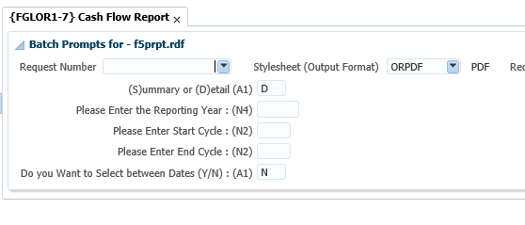
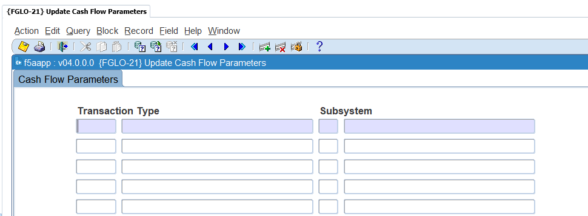
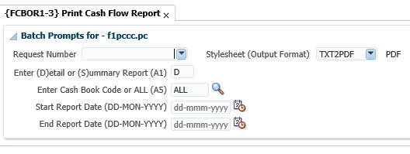
CASH BOOK SYSTEM
Can you produce a cash flow report?
Notes:
How many of you knows that you are able to produce a cash flow report?
The option {FCBOR1-3} allows you to print the amounts of all the monies in and monies out for a specified cash book and for a start and end date.
There is another option available for cash flow, where it is NOT just looking at CT and CB transactions. The option is on the menu {FGLOR1-7}. With that option you can add other TT’s that are NOT part of the CB/CT. You will do that in {FGLO-21}.

Slide 23
THANK
YOU
https://unsplash.com/s/photos/how-can-we-help
Notes:
There are a lot of things I can go through, but there are simply too many things. The question is how can we assist?
Are there processes or activities you do outside of the system – or where you think that the system could assist?
Please speak to us…

